Slide 1
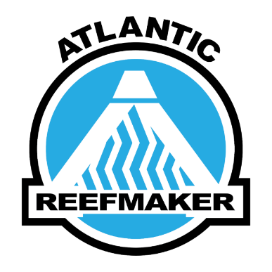


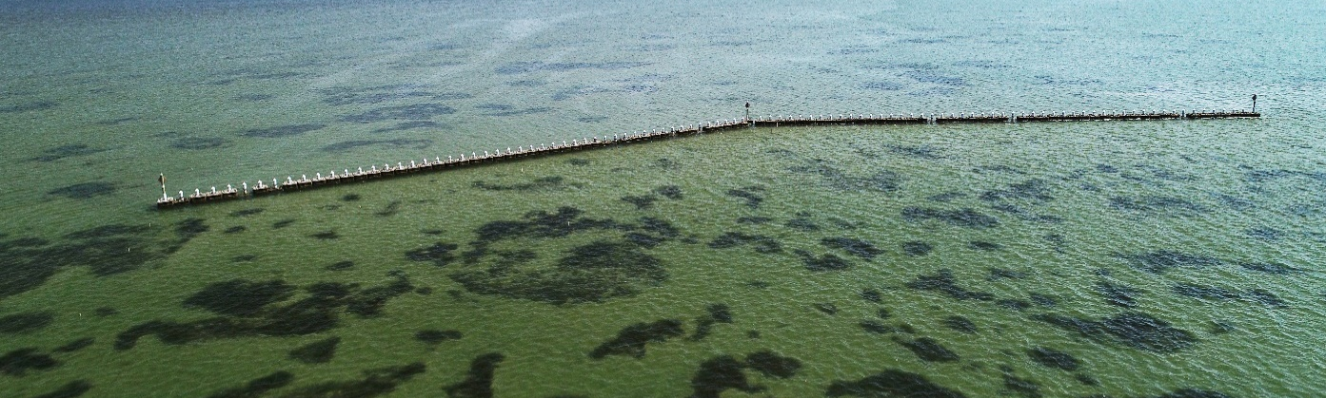
Bonner Bridge Submerged Aquatic Vegetation Mitigation
Phillip Todd (Atlantic Reefmaker)
Mark Fonseca (CSA)
Tyler Stanton (NCDOT)
Western Dredging Association

Slide 2
BACKGROUND
Bonner Bridge seagrass impacts
Bonner Bridge only direct connection of the NC Outer Banks to the mainland – in severe disrepair and is being replaced
Need 1.28 acres (0.52 hectare) new seagrass for Bonner Bridge impacts
No nearby candidate areas to be “fixed”
Here:
  Apply models of wave energy ↔ seagrass landscapes
  Reduce wave energy on patchy seagrass beds
  ↑Seagrass patch #, expansion, coalescence = increased acreage

Slide 3
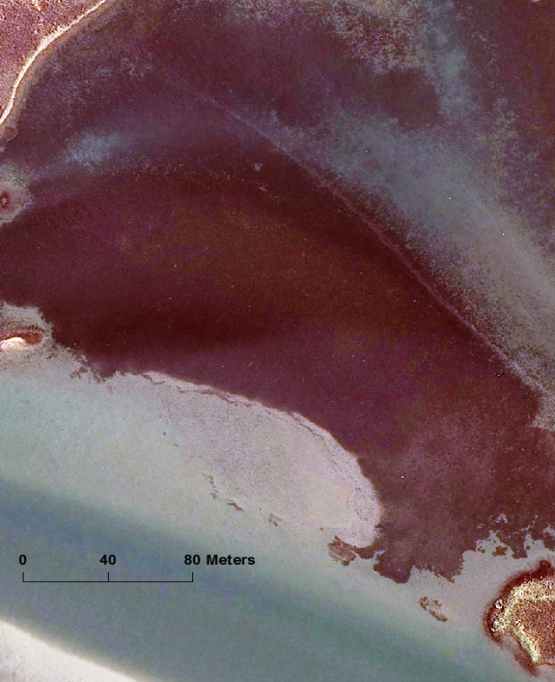
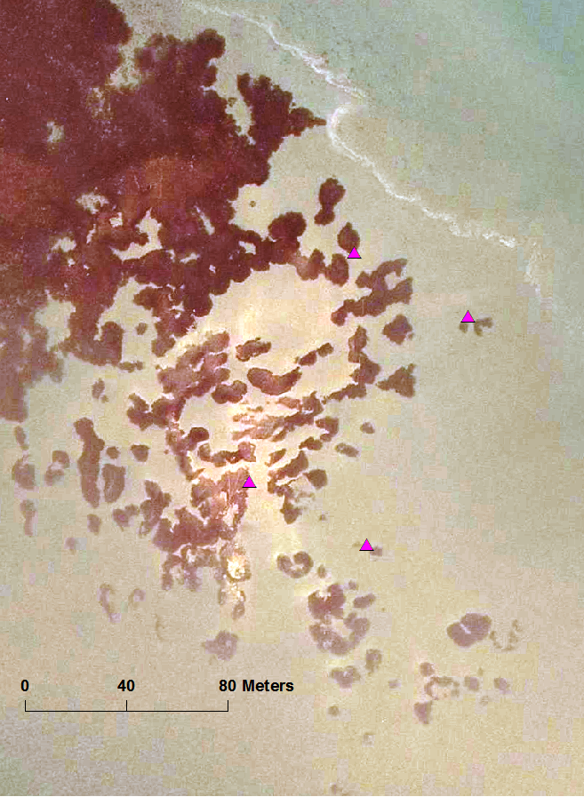
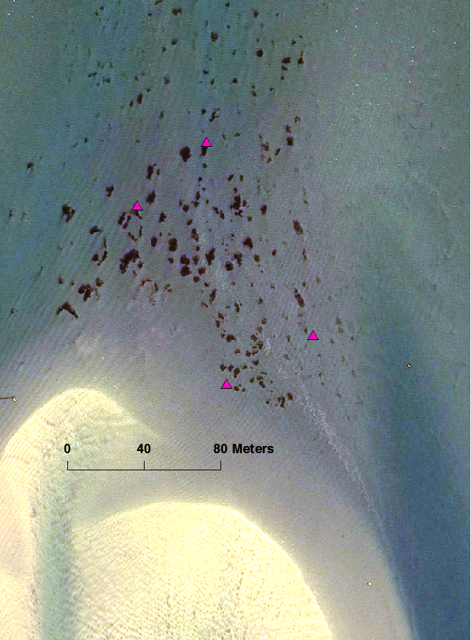
BACKGROUND
Seagrass landscapes change across disturbance gradients
Increasing currents, waves, bioturbation
(disturbance extent, intensity, duration, frequency, sequence)

Slide 4
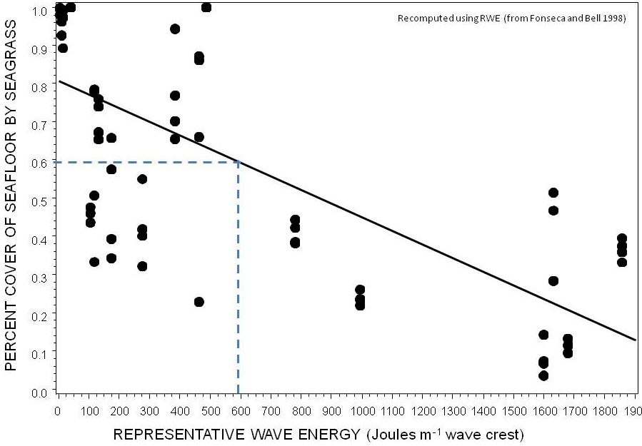
BACKGROUND
Tipping points in NC seagrass cover

Slide 5
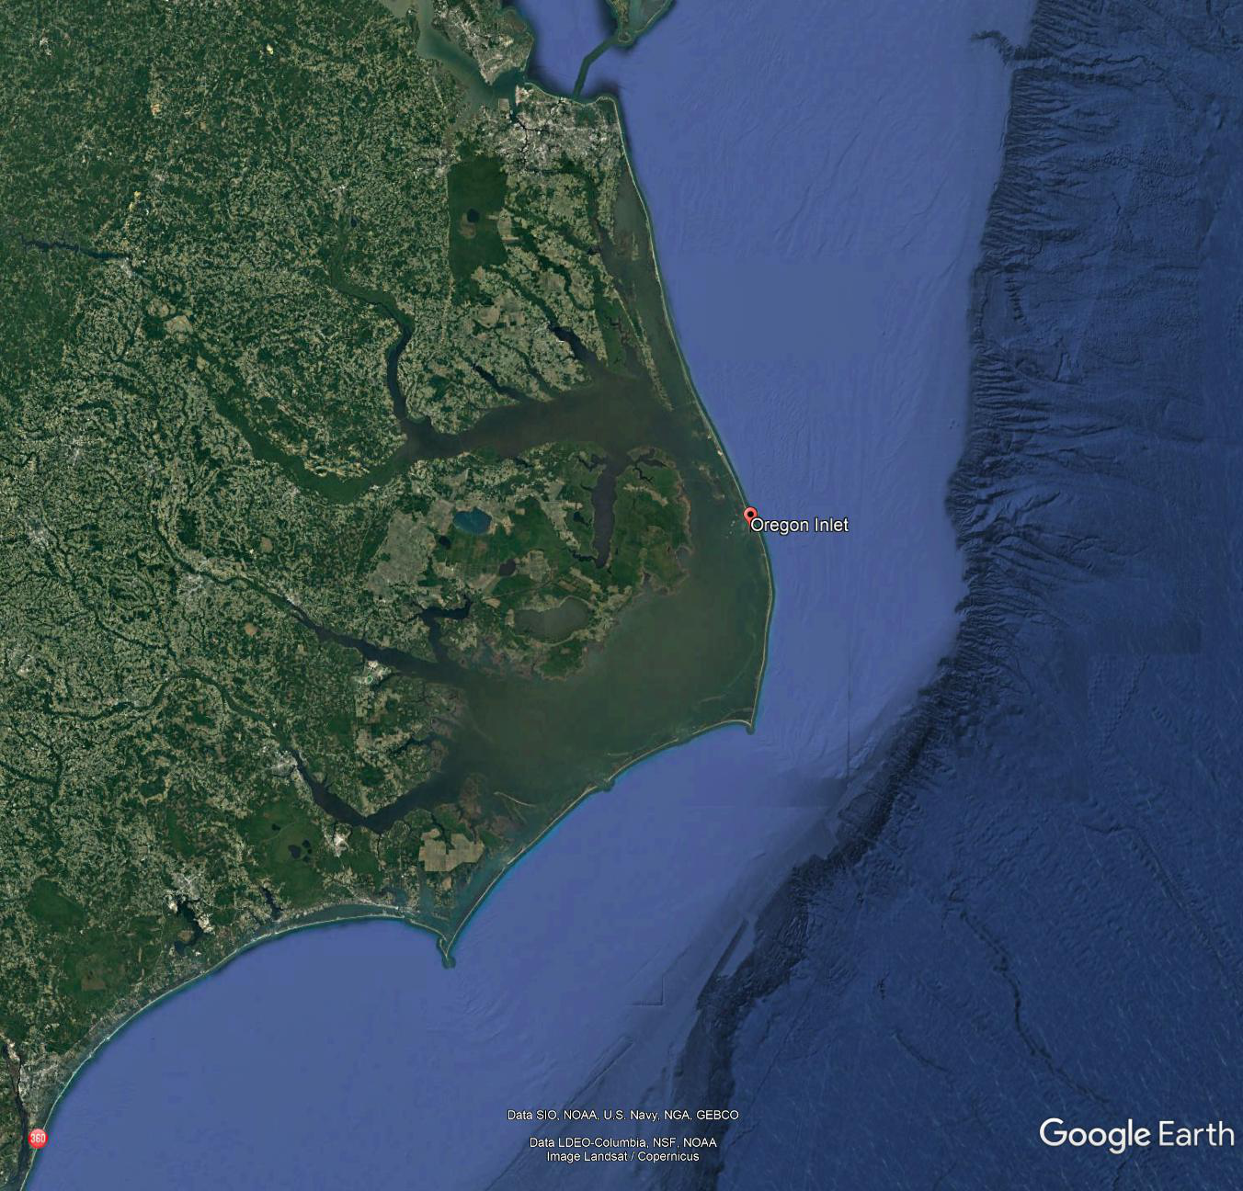
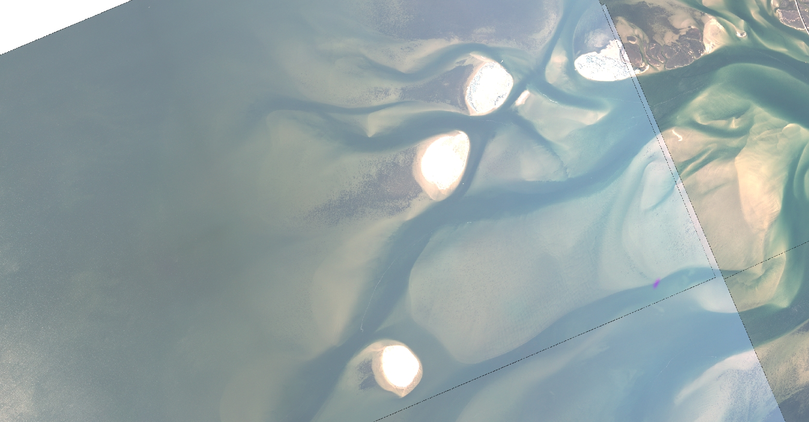
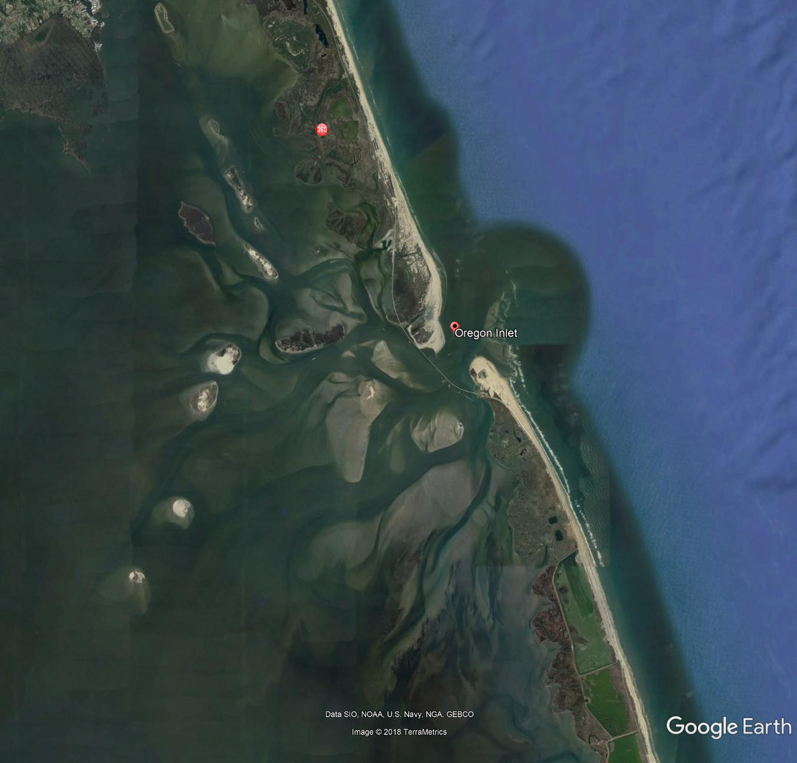
APPROACH
Mitigation location and strategy
Dredge material islands
Oregon Inlet & Bonner Bridge

Slide 6
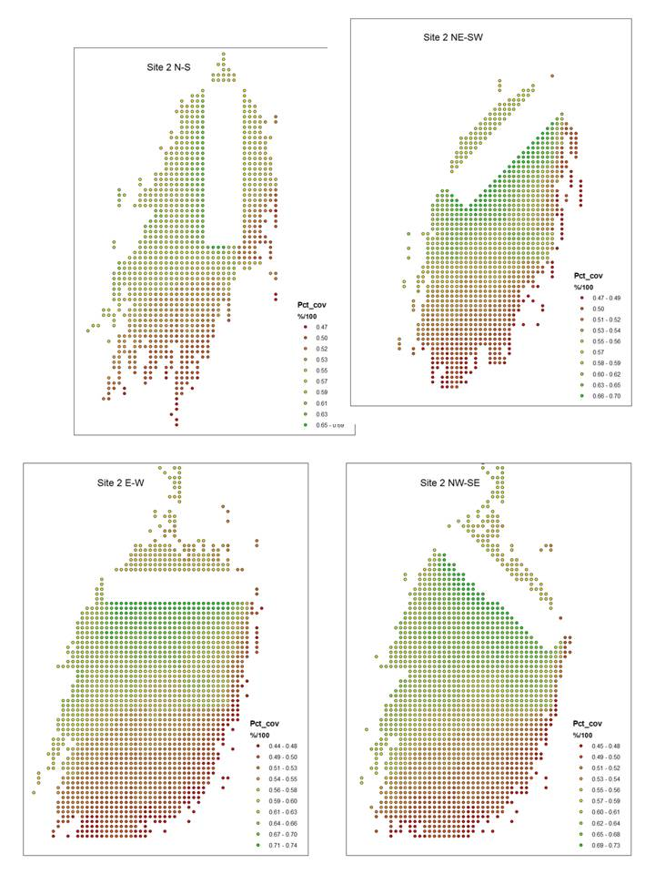
APPROACH
Forecast seagrass cover response to wave ↓
Seagrass cover f(RWE) before vs after wall
For every foot of wall we forecast ↑ 150 ft² (13.9 m²) of seagrass
500’ of wall = ~1.7 ac (0.69 ha)

Slide 7
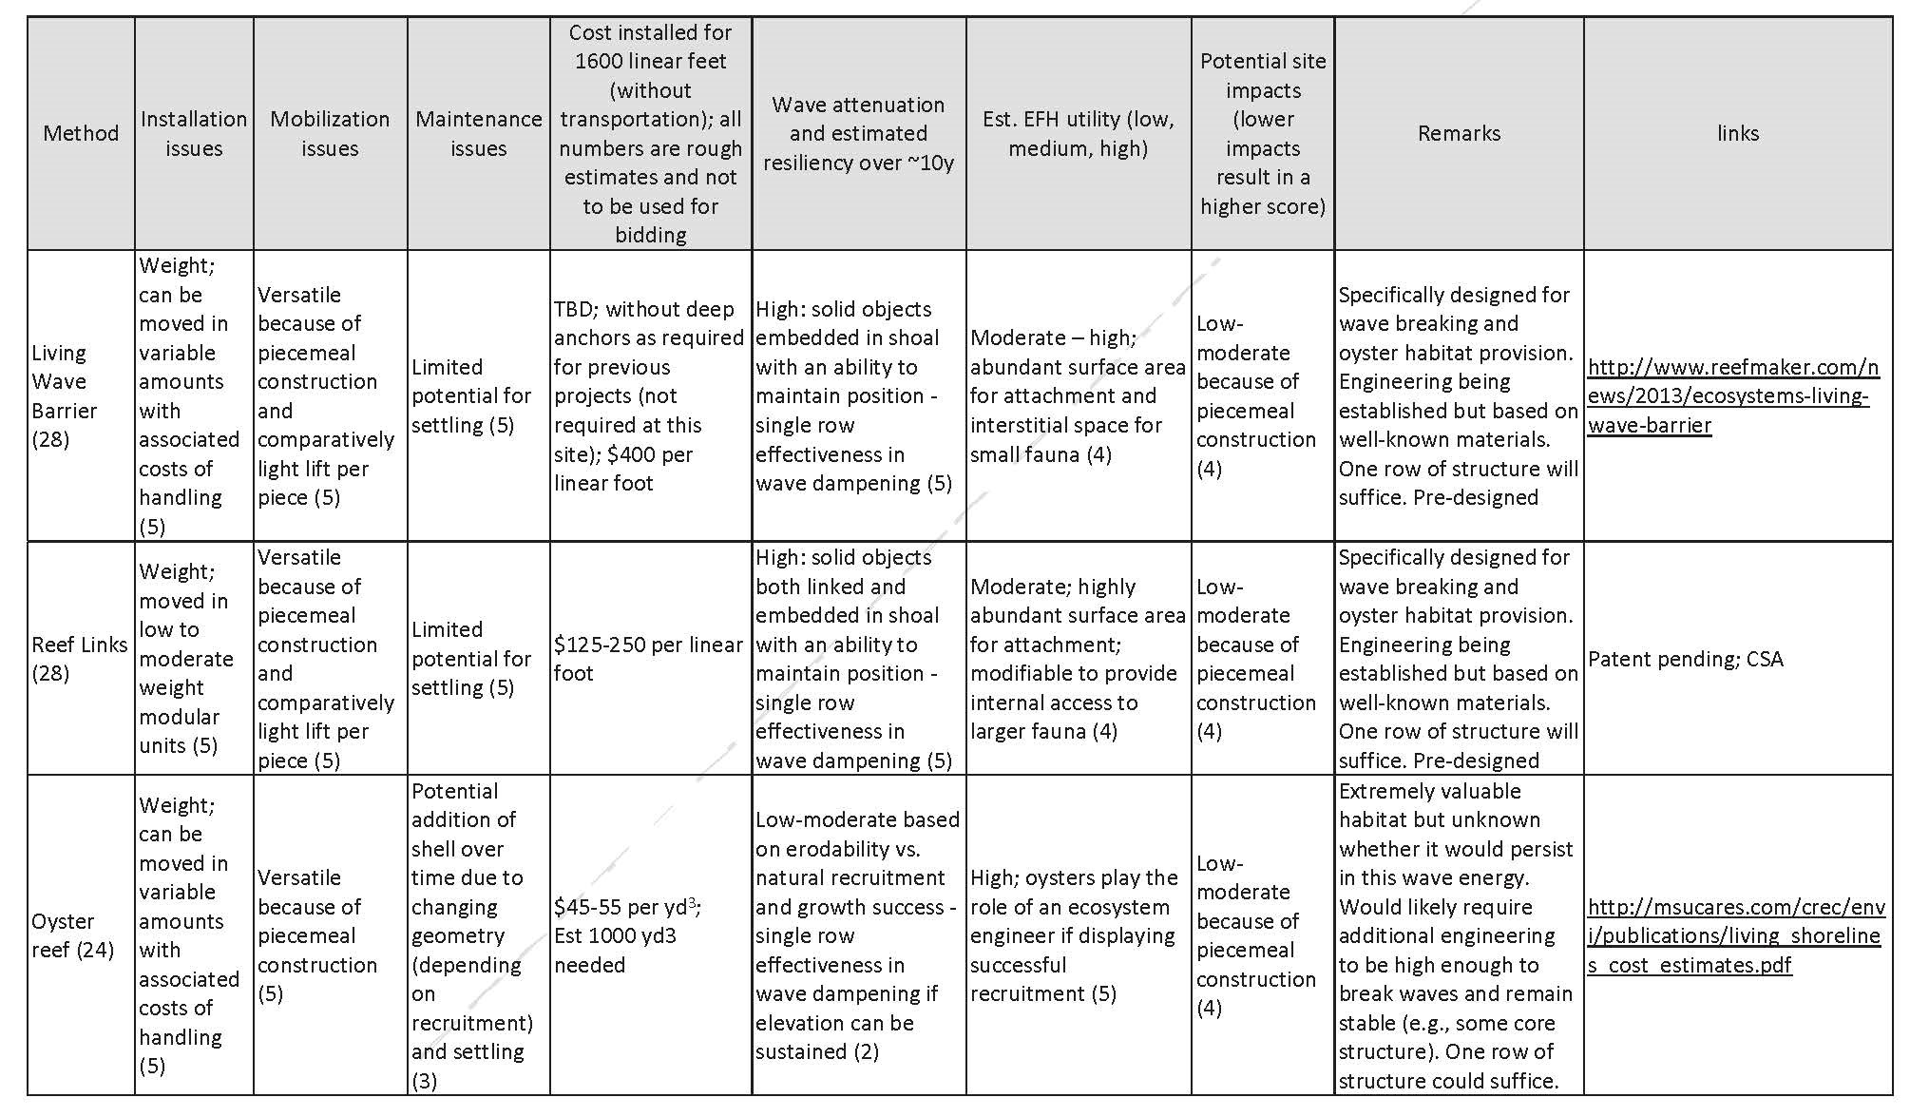
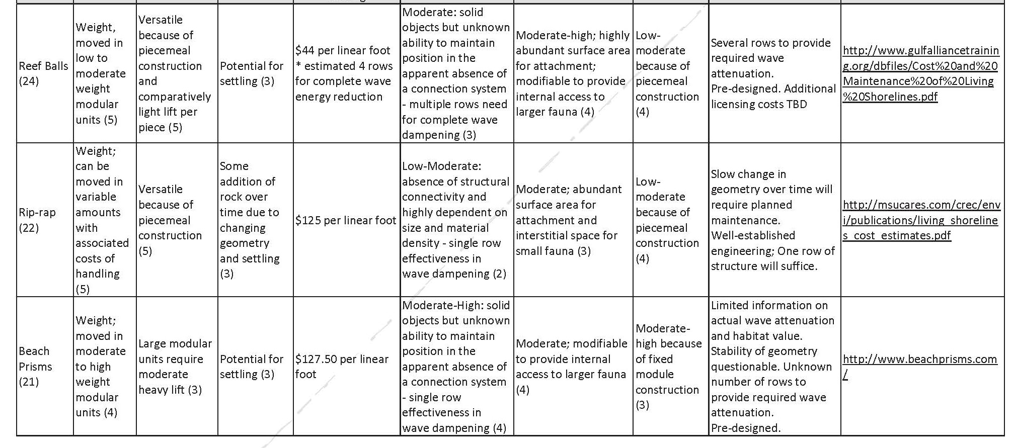
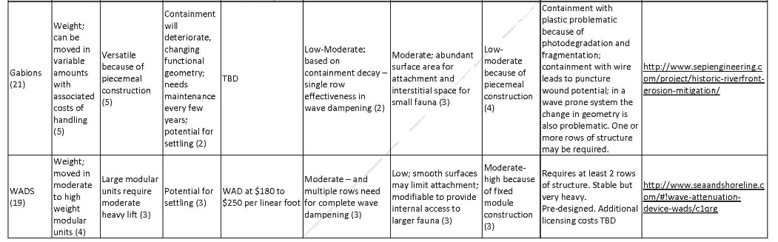
APPROACH
Mitigation Alternatives Analysis
Eight options
Factors reviewed/ studied
  Mobilization challenges
  Installation issues
  Maintenance concerns
  Costs
  Estimated essential fish habitat (EFH) utility
  Potential site impacts

Slide 8
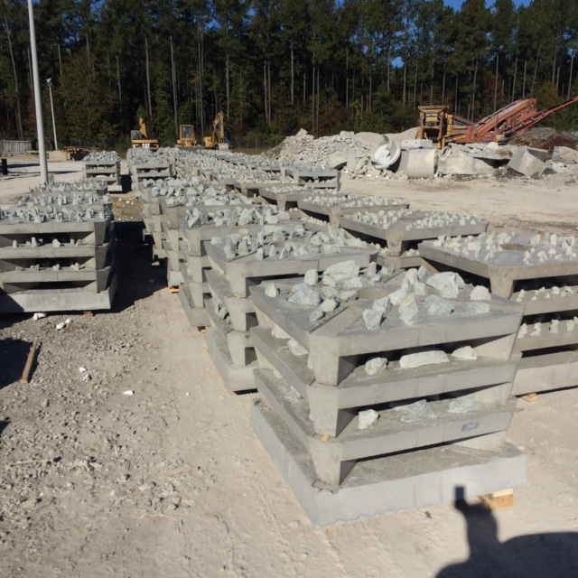
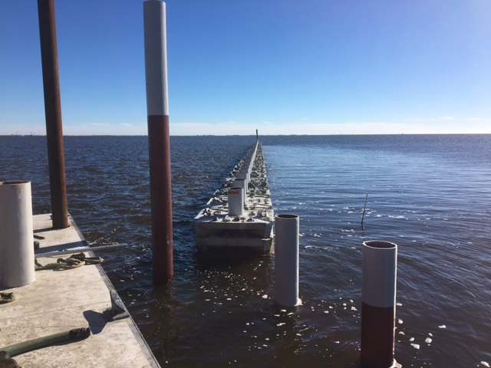
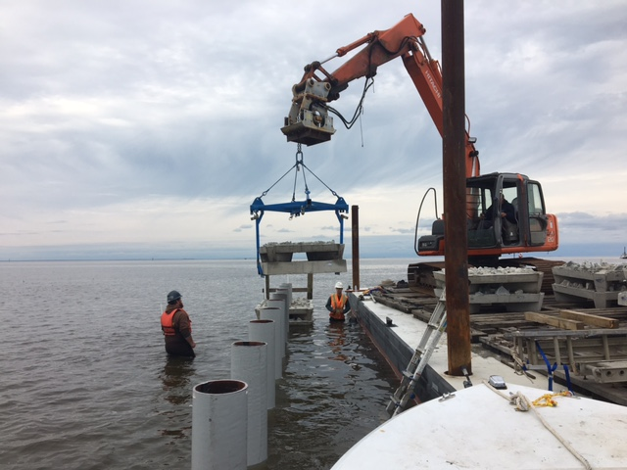
IMPLEMENTATION
Installation Dec 2016 – Jan 2017
Excavator pushed 12” diameter fiberglass pile into substrate (~25’ deep)
Installed in Low Draft Conditions
No access channel dug to the installation site

Slide 9
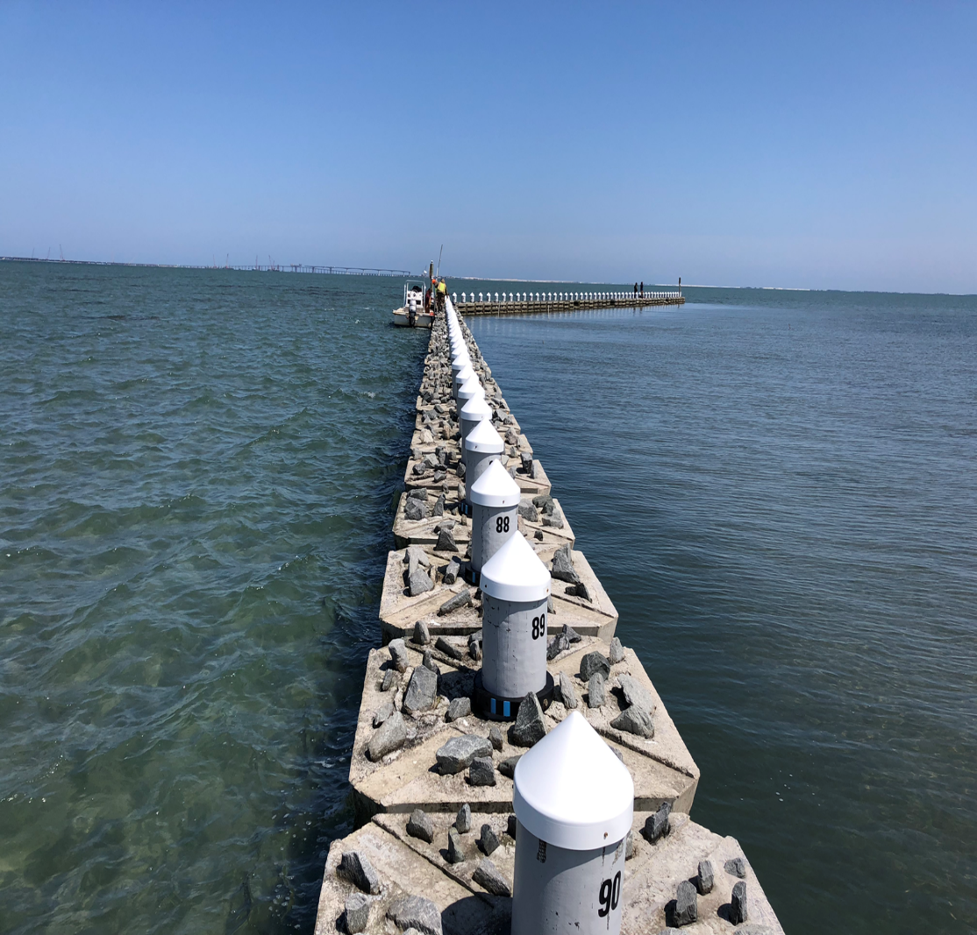
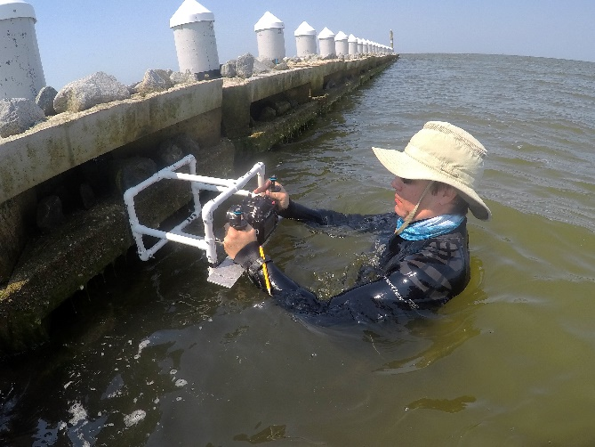
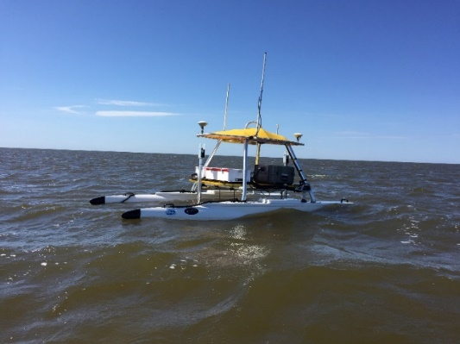
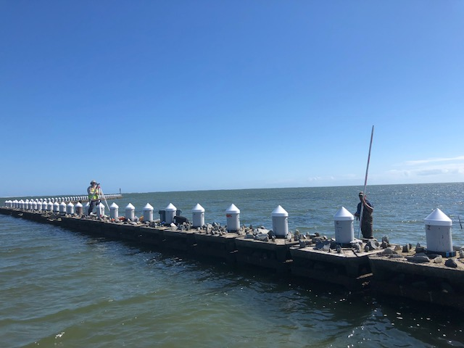
MONITORING
Installation Dec 2016 – Jan 2017
Δ Biological colonization
Δ Sediment elevation
Δ Seagrass coverage

Slide 10
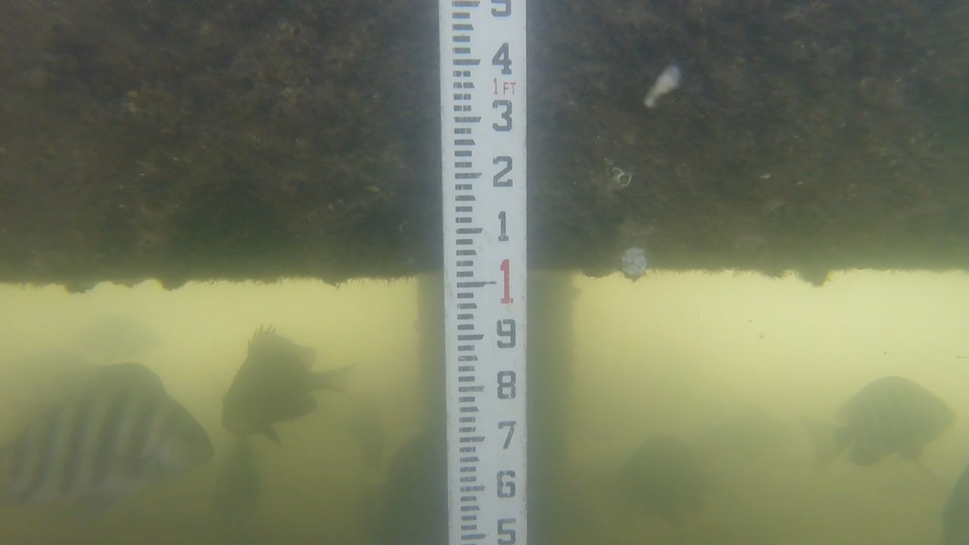
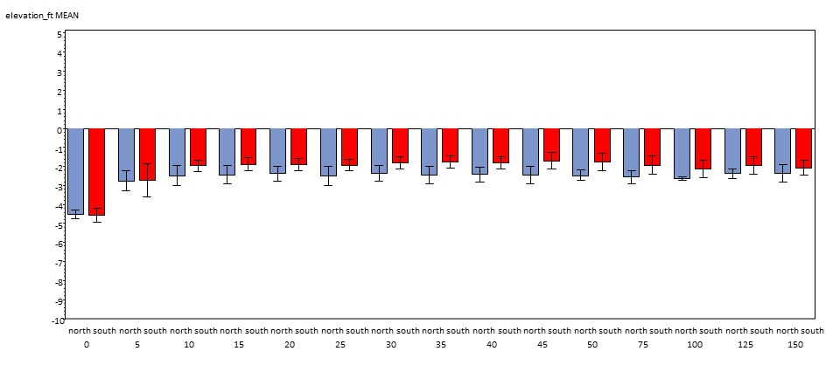
RESULTS
Near field sediment elevation survey
Transect surveys of elevation
Erosion pits under structure
Shoaling on south (lee) side

Slide 11
RESULTS
Near field sediment elevation survey
Embedded rock
Substrate % Cover | Infrequent Inundation | Frequent Inundation | Near-continual Inundation
Embedded Granite Rock | 0 | 19 | 17
Concrete Base | 27 | 70 | 90
Concrete base
~15% areal cover relocated seagrass

Slide 12
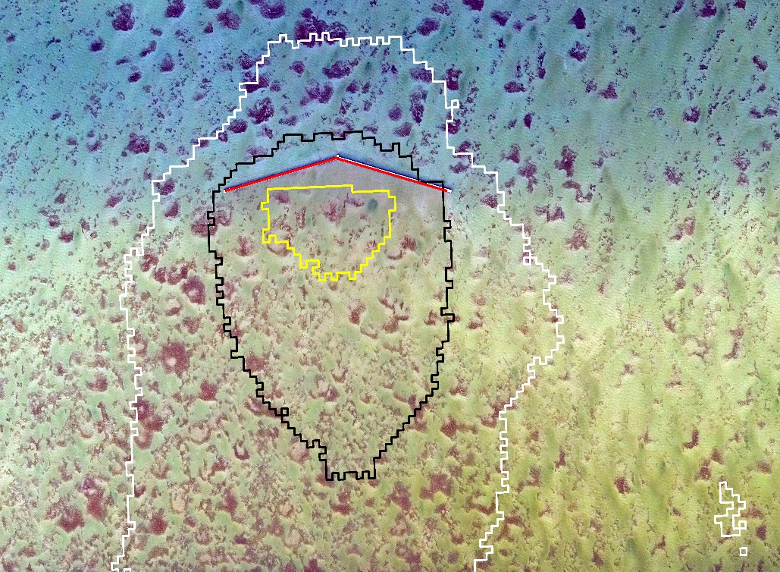
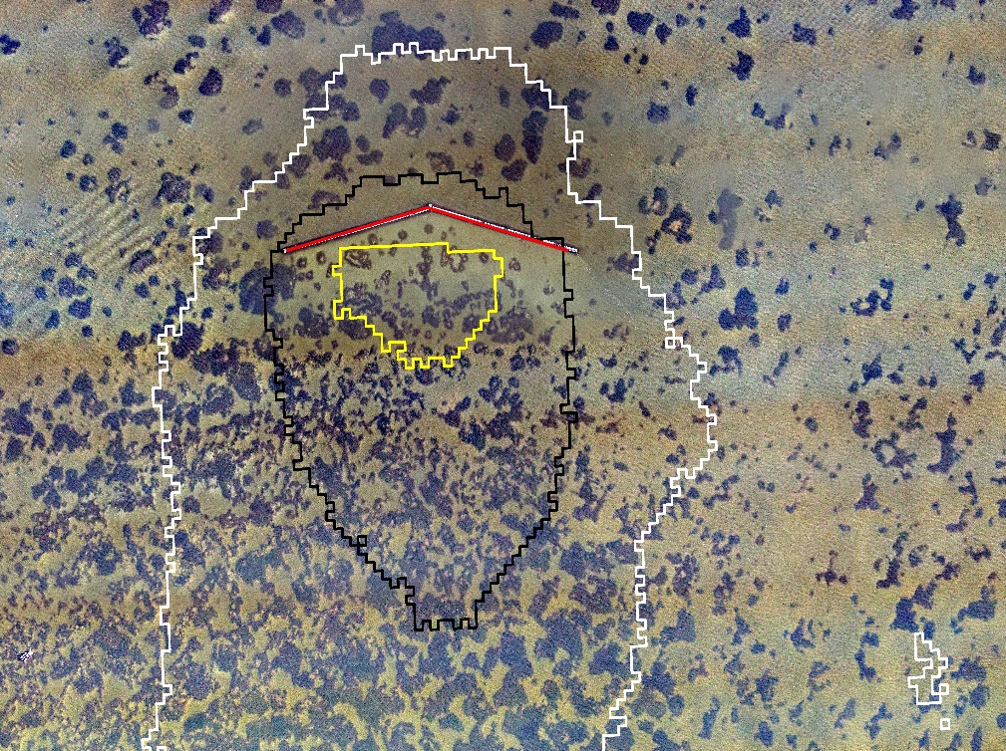
RESULTS
Epibiont Cover/Relocated Seagrass
January 2017
September 2018
4, ~2.5 ac (1.01 ha) Reference Zones
>66% energy ↓
33-66% energy ↓
5-33% energy ↓
+ 1.34 acres (0.54 ha) in zones with >33% energy ↓
Areas of assessment | % cover 2017 | % cover 2018 | Gain per base (ac/ ha) | Ref. adj change % cover
Reference areas (4, 2.48 ac/ 1.00 ha) | 16% | 20% | 0.22/ 0.09
Total area of >66% wave Energy decrease | 20% | 43% | 1.18/ 0.48 | 22%
Total area of 34-66% wave Energy decrease | 23% | 46% | 1.02/ 0.41 | 18%
Total area of 5-33% wave Energy decrease | 30% | 30% | 0.31/ 0.13 | 6%

Slide 13
Conclusions
Seagrass coverage changes across disturbance gradients
NC seagrass/disturbance well studied and modeled
Manipulation of gradient = changes in seagrass coverage
Reefmaker technology with suspended wavebreak structure:
  Supported new, persistent seagrass cover
  Provided substantial additional Essential Fish Habitat service
Cautiously optimistic - seagrass acreage > mitigation requirements
Continued monitoring to validate and improve forecasting

Slide 14
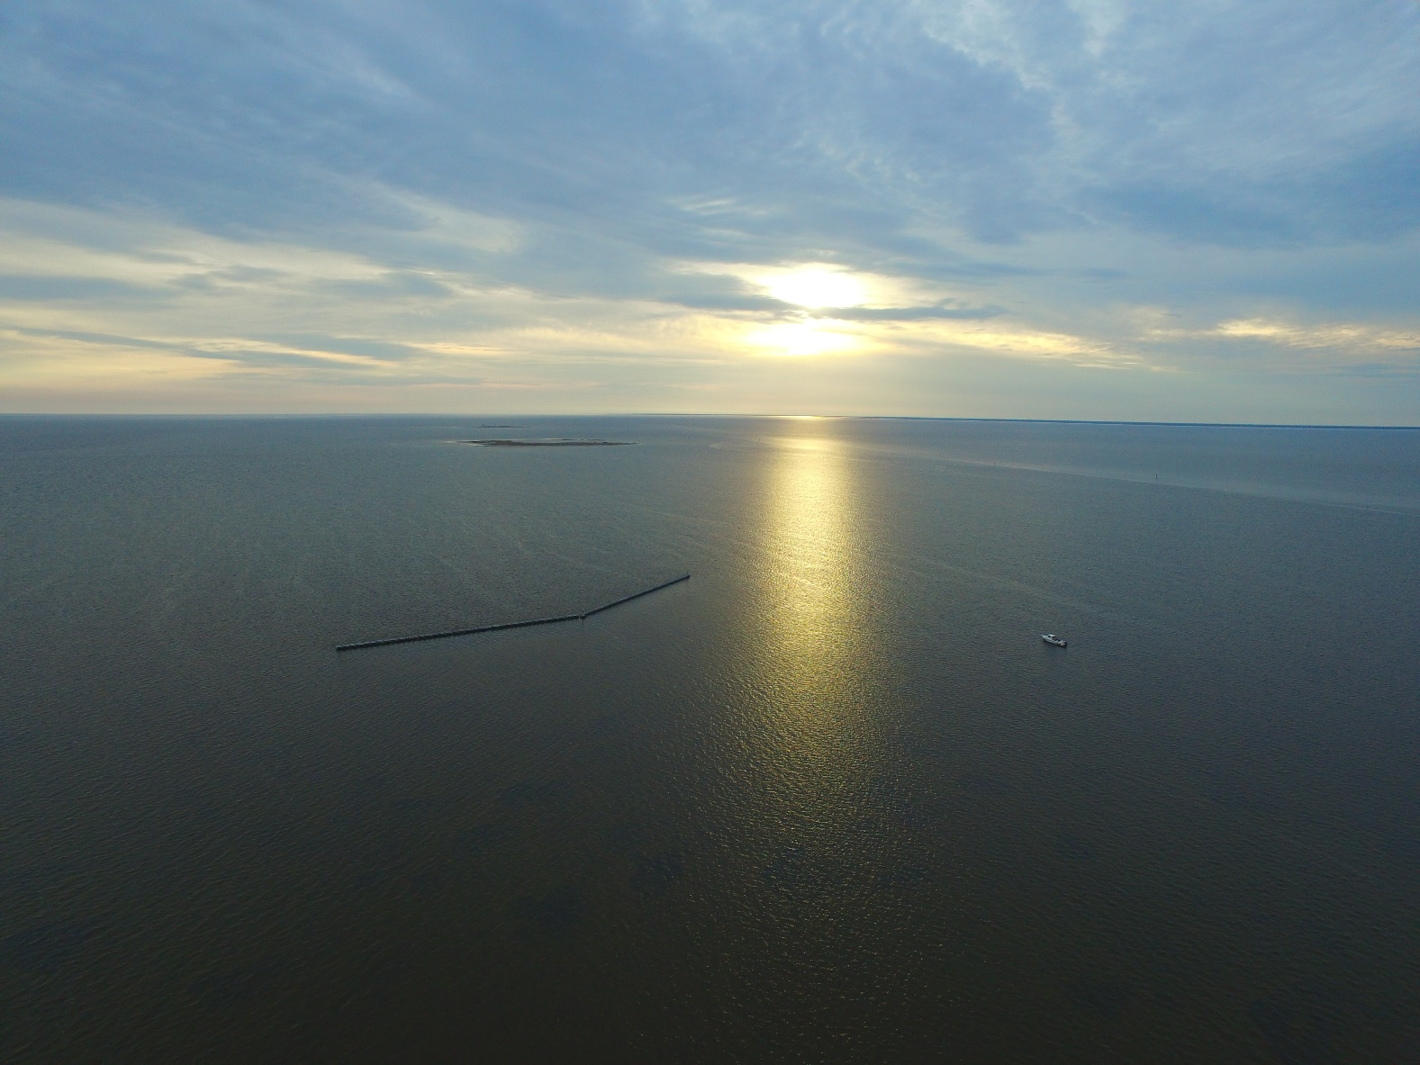
Questions?

